Slide 1
Institution
(symbolic capital, power relations)
Discourse practice
(forms of work)
Text
Description
Interpretation
Explanation
Notes:
14 words

Slide 2
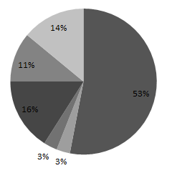
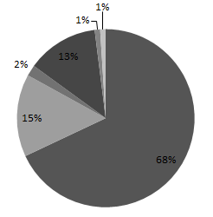
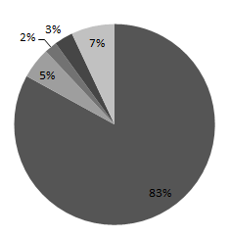
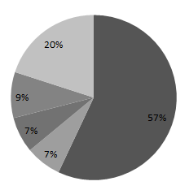
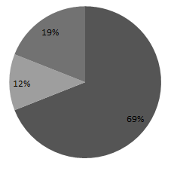
Period 1 (1929-1938) | Period 2 (1939-1945) | Period 2 (1946-1959) | Period 4 (1960-1989) | Period 5 (1990-2010)
Disruptive Events | Disruptive Event | Disruptive Events | Disruptive Event | Disruptive Event
The Great Depression, 1929 | World War II, 1939 |  | Scientific studies, 1962 ICA, 1962 Black Frost, 1975 Civil Wars | End International Coffee Agreement, 1992 Coffee Crisis, 1998
Forms of Work | Forms of Work | Forms of Work | Forms of Work | Forms of Work
Symbolic Capital | Symbolic Capital | Symbolic Capital | Symbolic Capital | Symbolic Capital
Quality Validation Prestige Recognition Tradition Loyalty Easy Healthy | Loyalty Fair Recognition Tradition Validation Prestige Energetic Enjoyment Easy Healthy Accessible | Fair Recognition Tradition Validation Prestige Energetic Enjoyment Easy Healthy Accessible | Loyalty Fair Recognition Tradition Validation Prestige Energetic Enjoyment Easy Healthy Accessible Specialty | Loyalty Enjoyment Fair Quality Aspirational Relaxation Tradition Easy Specialty
Coffee Drinking Tendencies | Coffee Drinking Tendencies | Coffee Drinking Tendencies | Coffee Drinking Tendencies | Coffee Drinking Tendencies
 | Standardization of coffee | “Coffee Break” Instant coffee | Decaf Specialty coffee | Fair Trade Coffee Organic Coffee
Notes:
164 words

Slide 3
DESCRIPTION
(Text)
INTERPRETATION
(Forms of work)
EXPLANATION
(Symbolic capital)
Standardization of products (132)
Routinizing
Quality
Specialty
Establishment of loyalty
(108)
Demonizing
Loyalty
Recognition
Enjoyment
Energetic
Easy
Association with energy (83)
Valorising
Tradition
Aspirational
relaxation
Validation
Association with traditions (47)
Mythologizing
recognition
Creation of a new organization (43)
Enabling work
Accessible
Healthy
De-legitimation of coffee consumption (55)
Undermining assumptions
Fair
Notes:
General example (59 words)

